Slide 1

The Legacy Lab:
Discovering Your Story & Strengths
Notes:
10:45 am
Welcome back everyone! We are so excited to share something we have been developing for a few years now. We are going guide you through this legacy lab workshop in hopes that not only will you build some new relationships with folks in the room today, but also something you can share with your workplace, older adults, or broader community. We have a facilitators guide to be used with the PowerPoint that we are happy to share
The Legacy Lab uses a “train‑the‑trainer” approach, but it’s designed to feel relaxed and fun. As we guide you through it, we’ll model how you can take this back to your own community and use it with staff, committees, coalitions, or program participants. The goal is to spark meaningful conversations about how people’s legacies contribute to the whole community. This isn’t a set of rules or instructions—it’s a flexible tool for building connection, whether that’s with older adults, teams, or even around the dinner table. It’s all about relationships and strengths, helping people connect their gifts to something bigger, which is really what asset‑based community development is all about.
You choose what and how much to share. Listening is our superpower. If you prefer to pass at any point, that is okay.

Slide 2
Acknowledgement of Community Contributors
Healthy Aging Alberta acknowledges the contributions of community organizers and practitioners who have advanced story-based discovery of gifts and the power of place.
Notes:
1 minute
Foundations & Influences
This workshop is based on an asset‑based approach that focuses on people’s strengths and what helps us age well. It also helps us to reframe the idea of seeing older adults mainly as needing services or support, rather we start from the belief that older adults have knowledge, skills, relationships, and lived experience that are important to their communities. This workshop is the culmination of on the work and ideas of community organizers, practitioners and those that use stories to help people discover their gifts and their connection to place. This guide is meant to be flexible—use it in ways that fit your community, while keeping dignity, cultural safety, and mutual give‑and‑take at the centre.

Slide 3
Creating a Welcoming Space
Care & Confidentiality: What’s shared here stays here unless someone says it’s okay to share.
Consent: We check in before sharing names or stories. Everyone owns their story.
Choice: You’re welcome to speak, pass, listen, or take a break - whatever feels right.
Curiosity & Respect: We bring different experiences. Let’s stay open, kind, and curious.
Shared Responsibility: We create this space together by listening well and making room for every voice.
Notes:
2 minutes
To get us started let's just set a few guiding principles that will help to ensure that we are entering into a brave space where folks feel comfortable to share as much or as little as they choose.
Care & Confidentiality: Like Vegas! What’s shared in this room stays in this room, unless someone lets us know it’s okay to share it more widely.
Consent: We’ll check in before using names or repeating stories. Everyone gets to decide what happens with their own story.
Choice: You’re invited to join in, listen, pass, or step out if you need to. Please do what feels right for you.
Curiosity & Respect: We all bring different life experiences. If we listen with intent we might learn something new!
Shared Responsibility: This space belongs to all of us, let’s do our best to make it comfortable for everyone.

Slide 4
Icebreaker Activity
Notes:
5minutes
Because we just broke the ice we won't do another icebreaker activity, however, it's important to note that these types of activities really help to get people talking and connecting with one another. When you bring this back to your community please consider something that is fun and playful to get people comfortable in this space. We learn best through play and having fun so keep that in mind as you plan your icebreaker activity.

Slide 5
Who Am I?
Example:
Where were you born and raised
  How has this shaped you (ex. farm life, different country, etc)
Things that matter to you (ex. Camping, hiking, being with family, etc.)
Where do your passions come from (ex. I am passionate about working with seniors because… family influence)
How do you show affection, (or care, or love language, etc.)
Include a personalized photo
Notes:
2 min
[Facilitator to provide a few bullets talking about their home, hobbies, and things that are important to them] Keep in mind, the way you share will mirror how other will

Slide 6
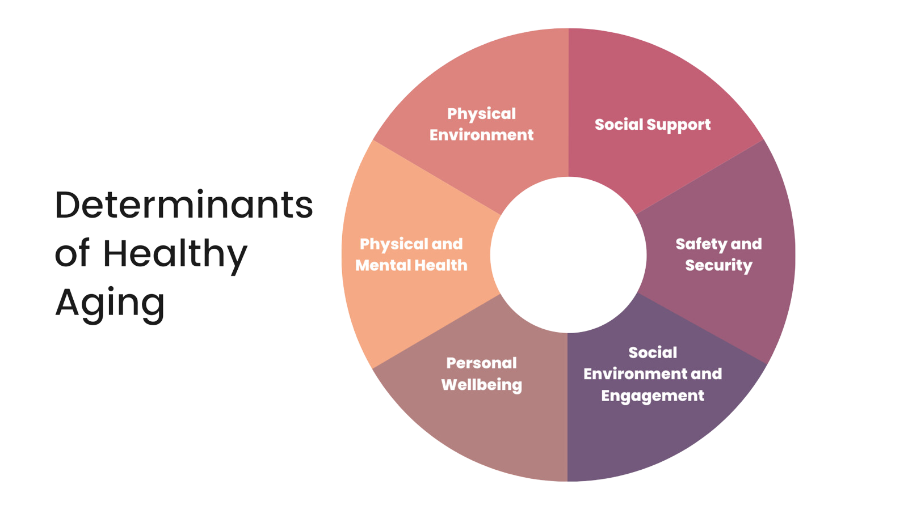
Determinants of Healthy Aging
Notes:
6 min
The Determinants of Healthy Aging were adapted from the World Health Organization’s social determinants of health. There are six key areas that we focus on at Healthy Aging Alberta and through our Healthy Aging Framework. These six categories include social support, safety and security, social environment and engagement, personal well-being, physical and mental health, and physical environment.
Healthy aging is shaped by more than medical care. It’s also influenced by the everyday conditions in which people are born, grow, work, live, and age. These social conditions like access to good food, safe housing, income, and strong relationships play a major role in overall wellbeing. In fact, research shows that more than 80% of a person’s health is affected by these social factors.
Everyone has strengths and abilities that support healthy aging, and when communities provide the right conditions, older adults are better able to thrive.
For example, when people have stable income, they are more likely to stay healthy and independent for longer. Supportive communities can also reduce the risk of disability and help people maintain their quality of life as they age.
Positive social connections are another powerful protective factor. Staying connected with others can lower the risk of dementia and other health challenges, while strong relationships help people live longer, healthier lives.
Clear, easy‑to‑understand information also supports good health. Many older adults face barriers when forms or documents are complicated, so improving communication helps people make confident, informed decisions.
As mobility changes with age, accessible and supportive neighborhoods make a big difference. When communities offer nearby grocery stores, safe walking areas, and inclusive public spaces, older adults can stay active, connected, and engaged.

Slide 7
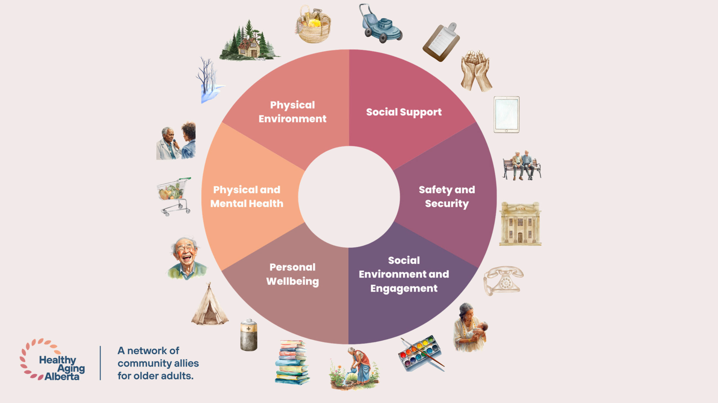
Notes:
8 min
There are many activities and programs that we interact with daily that fall into one of the six categories. I'm going to spend some time talking about some of these activities around the determinants of healthy aging. On the table you'll find a blank page that has the Healthy Aging wheel. As I'm describing some of the activities feel free to fill in on the sheet some of those key areas that you already interact with to see how your day-to-day activities contribute to healthy aging.
[Share a few examples in each category]
Determinant of Healthy Aging: Physical and Mental Health
Physical Health and Wellness
Community health clinics offering routine checkups, immunizations, and chronic disease management for older adults.
Physical Fitness
Low‑impact exercise classes such as walking groups, chair yoga, or gentle stretching programs designed for older adults.
Healthy Life Choices
Educational workshops that support smoking cessation, physical activity, and healthy daily routines.
Mental Health and Wellness
Access to counseling, peer-support groups, or stress‑management sessions addressing anxiety, depression, or isolation.
Brain Health
Memory workshops, puzzles, learning opportunities, or lifelong learning classes that promote cognitive stimulation.
Determinant of Healthy Aging: Social Environment and Engagement
Social Engagement
Weekly coffee clubs or interest-based groups that encourage regular interaction with peers.
Outdoor Activity
Organized nature walks, community gardening programs, or outdoor recreation days encouraging time outdoors.
Diversity and Inclusion
Culturally inclusive programming that respects varied backgrounds, languages, identities, and lived experiences.
Participation and Engagement
Opportunities for older adults to plan, lead, or contribute ideas to community programs or advisory groups.
Volunteerism
Programs that match older adults with volunteer roles such as mentoring, event support, or community outreach.
Determinant of Healthy Aging: Social Support
Information and Referral
Help desks or outreach workers assisting older adults in navigating available health, social, and community services.
Social Support Services
Companionship programs, friendly phone calls, or group activities designed to reduce loneliness.
Caregiver Supports
Respite services, caregiver education sessions, or peer support groups for those caring for family members.
Determinant of Healthy Aging: Personal Wellbeing
Resiliency
Workshops that build coping skills, adaptability, and personal strengths during life transitions or challenges.
Emotional Wellbeing
Programs promoting self-expression through art, music, or storytelling to enhance emotional health.
Personal Services
Assistance with everyday tasks such as grooming, mobility support, or appointment coordination.
Food and Nutrition
Meal programs, nutritional education sessions, or grocery support initiatives that promote healthy eating.
Determinant of Healthy Aging: Physical Environment
Transportation
Community shuttle services or volunteer driver programs that support access to appointments and social activities.
Housing
Safe, affordable, and accessible housing options that support aging in place.
Home Supports
In-home services such as housekeeping, minor repairs, or assistive devices to maintain independence.
Determinant of Healthy Aging: Safety and Security
Personal Safety
Fall‑prevention programs, personal safety education, or wellness checks.
Financial Security
Budgeting assistance, financial literacy sessions, or help accessing income supports.
Vocational Training and Support
Employment training, skill‑building workshops, or job placement support for older adults who wish to work.
Now that we've gone through the six determinants and some of the activities associated with them it is easy to see that there are so many ways that we contribute to our overall health and well-being. By recording some of these key activities next to the determinant of healthy aging it may also signal some areas that we might be lacking in.
Next, we're going to go a little deeper and get a bit of a better understanding of who we are sitting next to!

Slide 8
Who are you?
Notes:
4 min
Ok everyone, we are going to get you to stand up and face into the room. Now lock eyes with somebody. Next give them a fun little signal ( an nose wriggle, hair toss, finger guns). Have you signalled. Great! Now mirror the signal they sent to you back at them! Perfect now go sit with your new found friend! They are now your partner for the workshop! Now we know that was akwards for some of you, so please put up your hand if need support finding a partner!
Between the two of you Assign a Speaker 1 and a Speaker 2. To begin, Speaker 1 will introduce themself by sharing where they were born, raised and how they came to be where they are today Share how, people, places, ideas, and culture shaped your life. Talk about how you show affection and spend your time (we have prompts on the next slide) Speaker 2’s job is to listen
You will have 6-minutes, your time starts now!
[Set timer for 6-minutes]

Slide 9
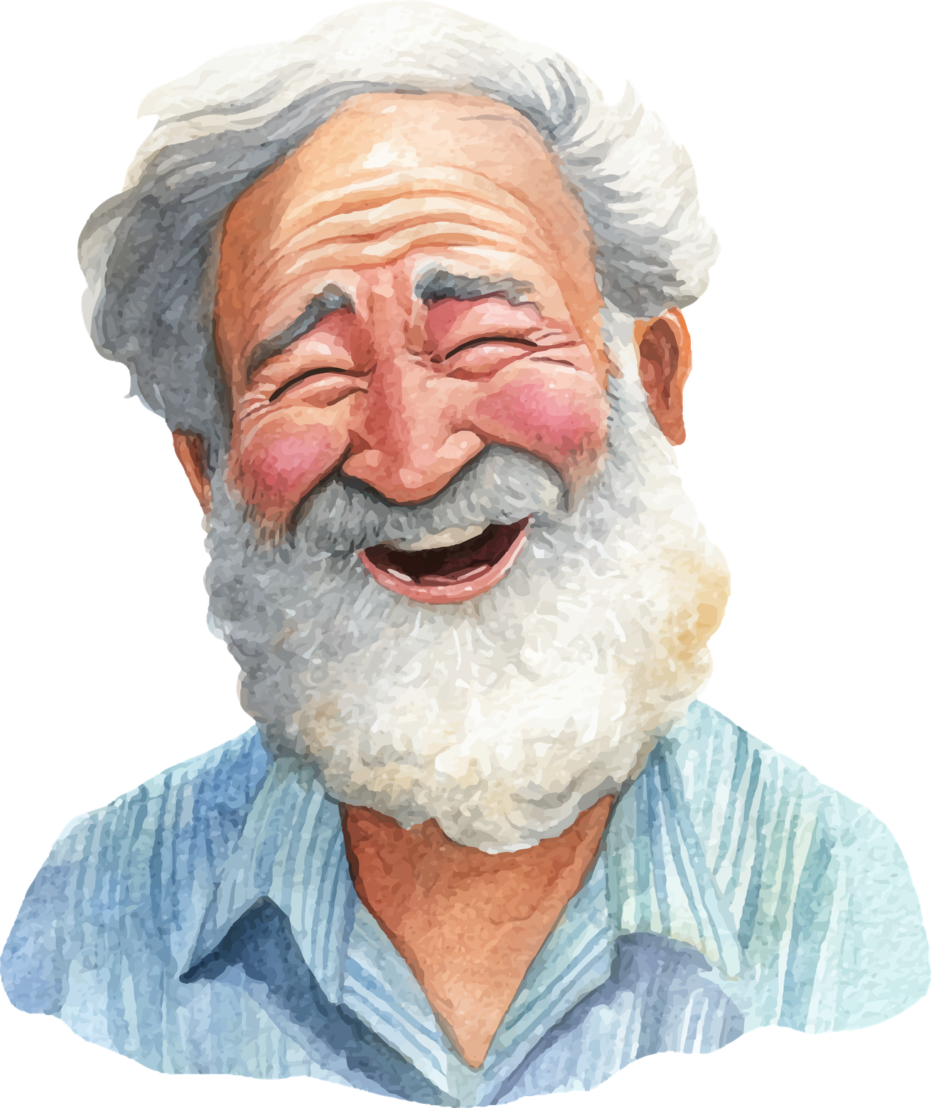
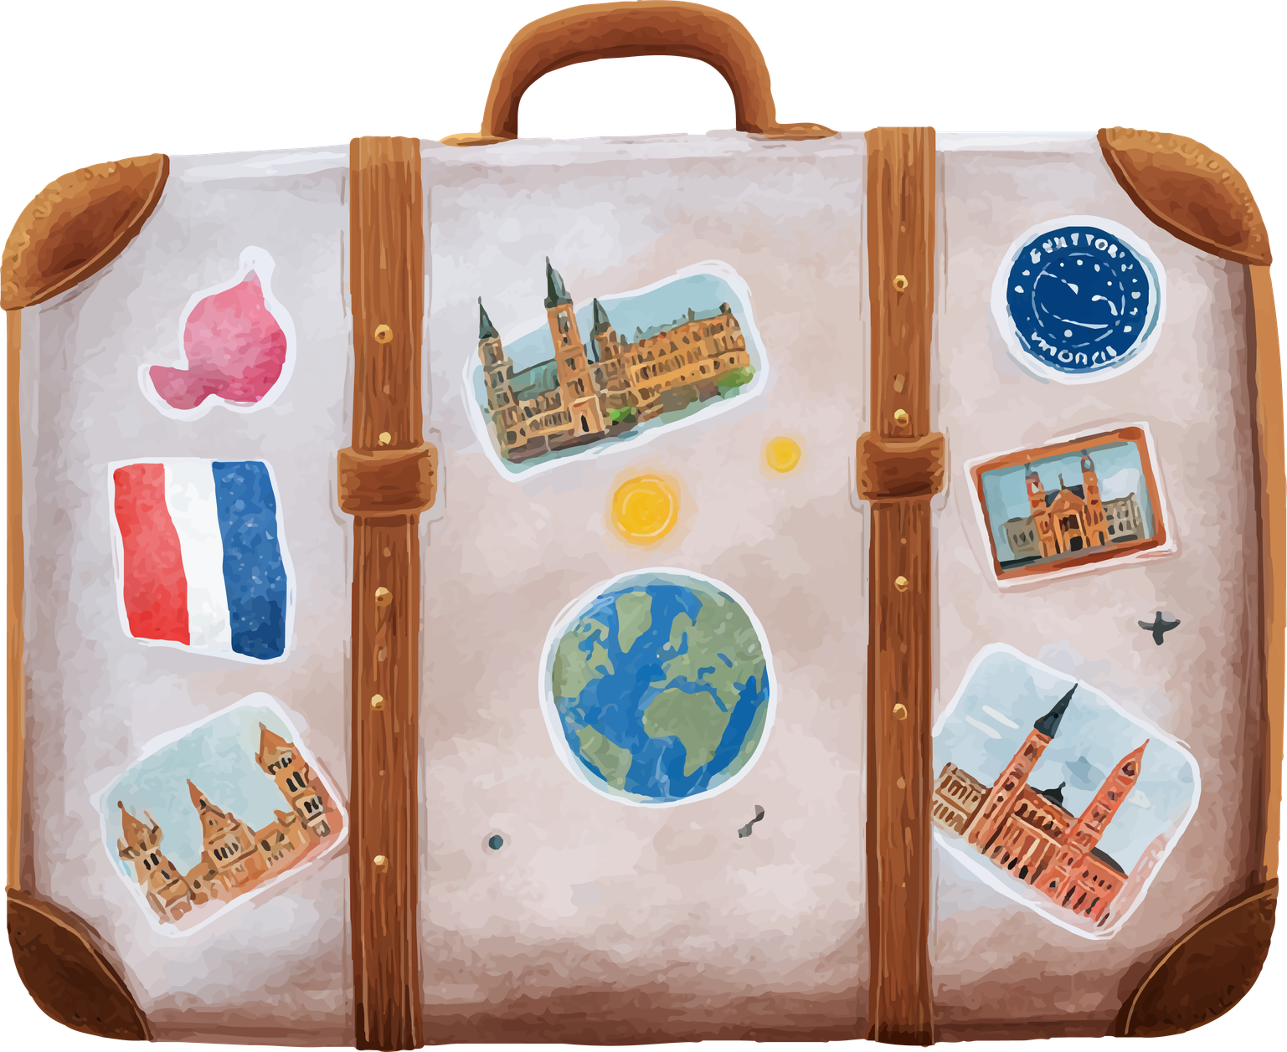
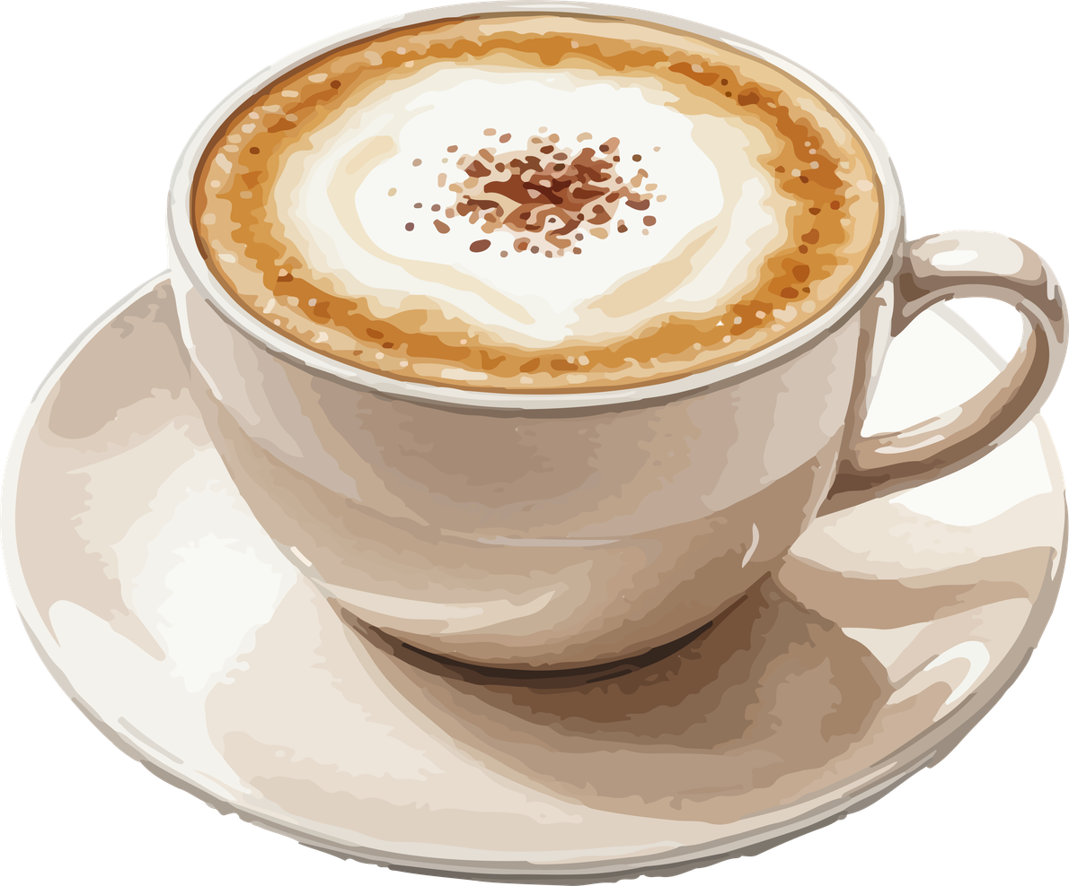
What Has Shaped You?
Where do your passions come from (ex. I am passionate about working with seniors because… family influence)
Things that matter to you (ex. Camping, hiking, being with family, etc.)
How do you show affection, (or care,love language, etc.)
Where were you born/ raised
How has this shaped you (ex. farm life, different country, etc)
Notes:
[Set timer for 6-minutes]
Give one minute warning at 5 min
After 6 minutes call group back in
Hi everyone! It is so good to hear all this conversation! I am going to ask you to switch now! It is now speaker two turn to share!
[Set timer for 6-minutes]
Give one minute warning at 5 min
After 6 minutes call group back in

Slide 10
Open Sharing: Any surprises or similarities?
Notes:
Let's take some time to share back to the rest of the group on some of the stories that you heard. Give a little nod as permission to share each others' stories
[Have people raise their hand to share about any surprises or similarities to their stories. Prompting questions can include things like: were any of you shaped by similar circumstances, or that perhaps you grew up near by?
This opening exercise about who we are really matters, because strong communities start with people understanding themselves and one another. When we take time to share our stories, we begin to notice both what we have in common and what makes each of us unique. Our shared experiences help us connect and build trust, while our differences bring new ideas, perspectives, and opportunities to learn. Even when we think we know someone well, listening more deeply can help us see what has shaped them and what they bring to the table today. This kind of understanding lays the groundwork for community development—and it’s something that can be powerful to bring into your own organization, group, or hometown to strengthen relationships and uncover the strengths already there.

Slide 11
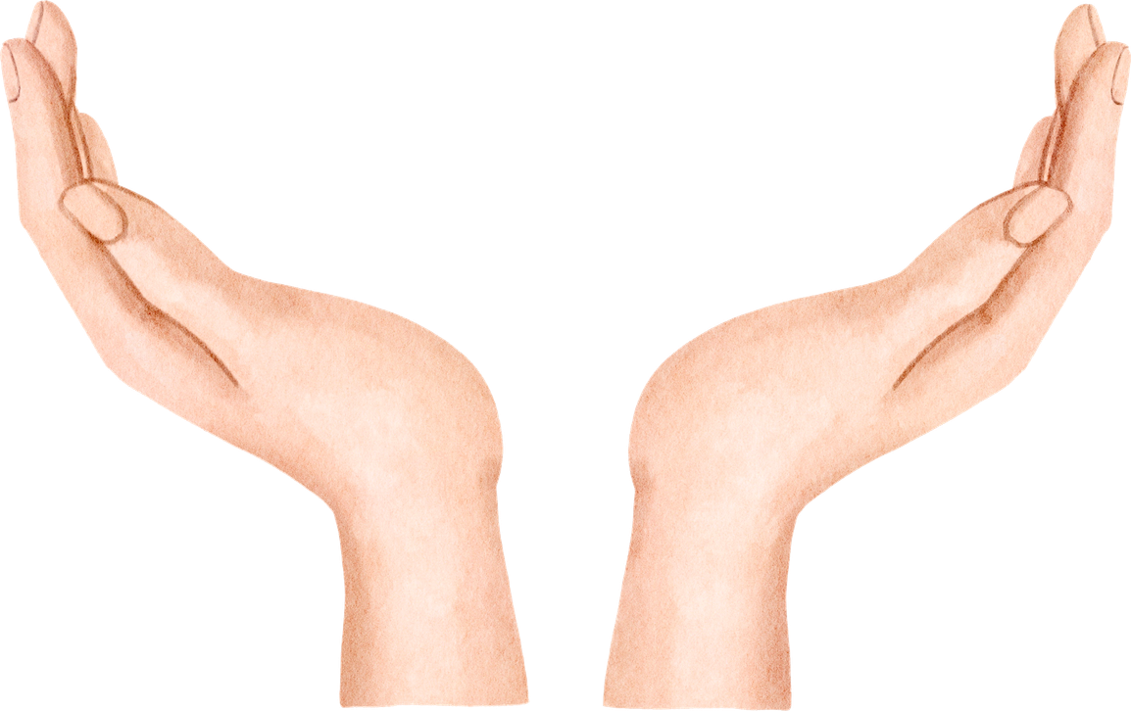


Self-Reflection
What are your talents or skills?
(Big or small!)
What pulls your heartstrings?
Where does your passion lie?
What knowledge do you hold?
Notes:
5 min
Now that we've had an opportunity to learn each other's stories and share back to the group we will spend about 5 minutes in self reflection.
[Lift up the TPK Reflection 1 Handout to guide participants on what page to use]
On your tables you'll see a handout titled TPK Self Reflection #1. As I am explaining these sections, add your reflections on the handout, we will reference these again.
Reflect on your talents and skills.
What are you good at? What do people come to you for?
What practical skills do you have and enjoy doing? This could be carpentry, gardening, cooking, or playing a musical instrument.
What could you teach others how to do?
TIP: If you are finding it hard to think of something the way we show affection is one of our greatest skills for connecting to others. Reflect on how you like to show people that you care
Next reflect on your passions and heart-work.
What do you care deeply about? This might include things like protecting the environment, music, community life, or working with children.
What activities, subjects, or circumstances interest you the most?
And finally, what do you know?
What information do you have that you enjoy talking about or teaching others? Examples might include local history, specific films, sports, bird watching, or a particular area of study or a professional skill.

Slide 12
Open Sharing:
A few participants can share one item from
each category
Notes:
6 min
Let's spend about 5 minutes in open discussion about some of your talents, skills, passions, and knowledge. Remember everybody has the right to share as well as the right to pass. I will record some of the responses here at the front on this flip chart paper. I'm only including specific talents, skills, knowledge, and passions, but I won't associate it with anyone in particular.
Who would like to be the first to share?
[As people are providing their responses to the reflection begin to record some of the key areas of talent skills passion and knowledge on a flip chart paper at the front of the room. Do not include names but rather just the areas of interest]

Slide 13
Self-Reflection
What skill or talent do you want to learn or enhance?
What do you want to explore more?
What makes you curious?
What would you like to know more about?
Notes:
4 min
Thank you to everyone who is willing to share about their talents, skills, passions, and knowledge with the broader group. We have an amazing group of individuals bringing fantastic gifts with them into this room!
Next, let us reflect on some of our learning edges. Your learning edge is the place just outside your comfort zone, where you’re growing and learning something new. This is where curiosity blooms into new skills and interests.
On the second self reflection page [Lift the page for all to see] you can record some of the talent skills knowledge and passions that you would like to learn more about or be able to do on your own. Think big or small but consider that there might be others around you who have this skill and they may really want to share it. These intersections could also act as that point of connection to others in your community.
I will give you 4 minutes to do this. Your time starts now!
[set timer for 4 minutes]

Slide 14
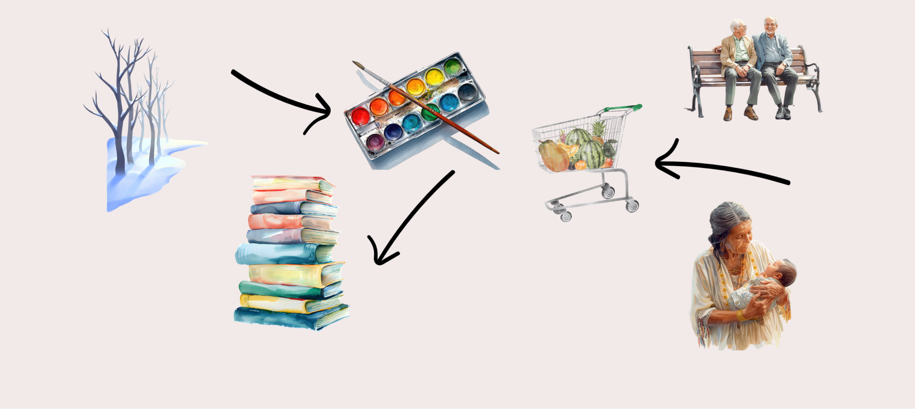
Share Back: Is There A Match?
Notes:
8 min
Let's take another opportunity to share back to the rest of the room on some of our learning edges. I'm going to record some of these on the same page in a different colour so that you can see some of the matches and connections. As people are sharing, please feel free to shout “MATCH” when a learning edge matches one of your skills, talents, passion, or knowledge.
[Give about 5 minutes for people to share to the broader group . As the facilitator record some of the responses on the same sheets in a different colour. Spend about two minutes connecting some of these learning edges and skills and talents to the social determinants of health and highlight how we all contribute to healthy aging in more than just formal programs and services.]
Know we understand that matches may or may not be feasible in this larger group, but we felt it was important to demonstrate that when we take time to notice the skills, interests, and experiences people bring into the room, something powerful starts to happen. When one person shares what they know or love to do, it often connects with something someone else wants to learn. Those connections can shape strategic directions, spark new programs, and lead to passion projects that feel meaningful because they come from real people, not top‑down plans. Just as important are the smaller, everyday connections that grow naturally—like a book club forming, two people trading recipes, or someone offering to walk with a neighbour. These kinds of natural supports strengthen community in ways that formal services never can. When people are invited to contribute in ways they care about, energy builds, movement happens, and participation feels fun instead of forced. This approach also helps shift the story about aging—from one that focuses on needs and limitations to one that recognizes older adults as capable, creative, and deeply valuable contributors to community life.

Slide 15

Table Share Back:
Describe this Experience
Notes:
10 minutes
Wow, talk about an amazing way to get to know each other in such a deep meaningful way. It is very clear from today's exercise that everybody has something to contribute to their community.
Ask: Did you feel a sense of connection during this workshop? What moments helped you feel more connected to others, and why did that matter to you?
Ask: How could this way of focusing on people’s skills, interests, and passions support stronger relationships and more age‑positive community development in your organization or hometown?
A lot of what we talked about are the building blocks of asset-based community development . When we can identify the assets within our community and within the individuals that we work and interact with on a regular basis we really are able to begin to see what is possible with very little resources. Our individual stories, talents, and skills really are the best resources in supporting healthy aging within our communities.
At your table group, decide on one word or phrase that wraps up your collective feelings and reflections on this workshop! Have a speaker from each table share back to the larger group!

Slide 16
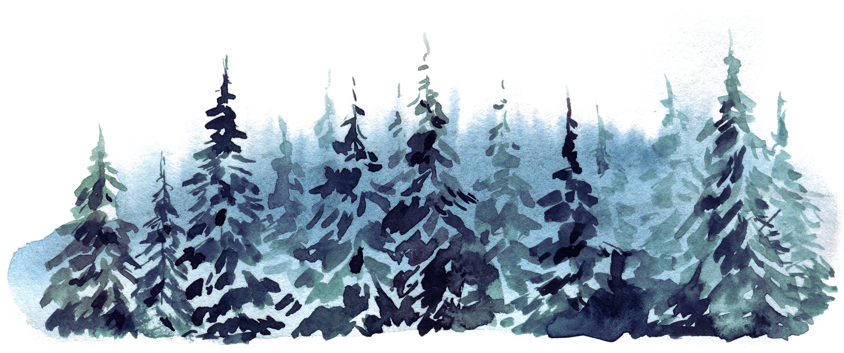
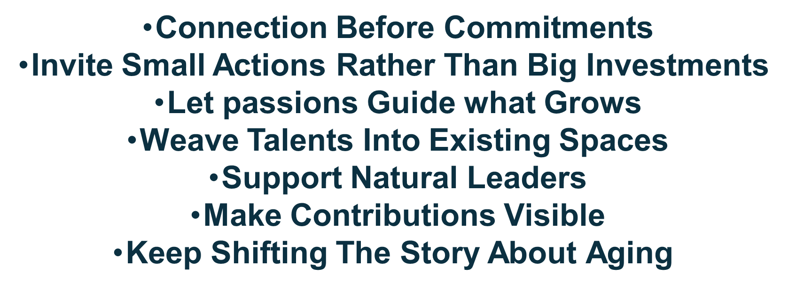
Reflections
Notes:
Thank you again to everybody who has shared back to the broader group! In this part of the workshop we would encourage you to create some possible next steps of what you want to do with the information you gathered. De’amon Harges (a community development guru and inspiration to us) says once you uncover the gifts in your communities you have an obligation to use them. Here are some things you could consider:
Start with simple connections
Create low‑pressure ways for people to connect around what they care about.
Small, doable steps build trust and momentum.
Ask: “What’s one small thing you’d enjoy doing together?”
Trust that when people care, they show up
Pay attention to what people light up about.
Support ideas that have energy, not just ones that look good on paper
Allow projects to evolve naturally instead of locking them into plans
Passion fuels participation—and fun keeps it going.
Look for ways gifts can strengthen what’s already happening This keeps things sustainable and place‑based.
Name and celebrate what people are offering. This reinforces the message that everyone has something to offer.
Notice who brings people together, Ask what support would help—not what rules to follow
Leadership doesn’t need a title to be real.
Use language that reflects strengths and value. Talk about older adults as contributors, mentors, builders, and neighbors
As you head back into your work and communities, we hope you’ll keep these ideas in mind and use them in ways that feel meaningful, practical, and even fun!

Slide 17
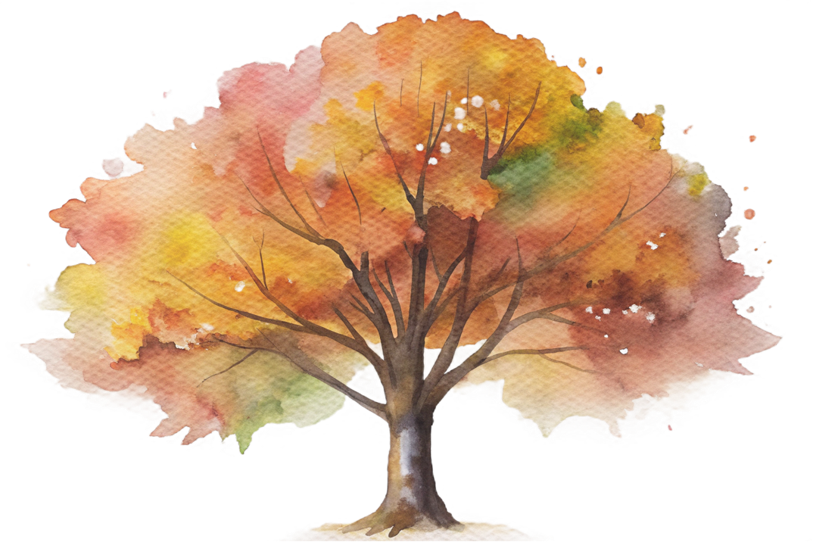
Next Steps
This workshop is for you to use, adapt, and share!
Facilitator Guide and the Legacy Lab PowerPoint will be shared in the post-event email
Provide us with feedback if you choose to bring this to your community!
Notes:
As we close out this session, I want to remind everyone that this workshop is for you to use adapt and share with others within your organization or community. We hope that this workshop offers a unique way to connect with your members of senior's clubs, clients in your organization, or even around your staff room table to get to know one another better.
We will be happy to share the facilitators guide as well as an editable Legacy Lab PowerPoint that you are free to use. We're also always open to feedback as you are aware, so if you have anything that you would like to share, please do so. As well, if you are going to bring this to your community let us know how it went!
As a community developer I am also pleased to be able to co-host a workshop with your members or program participants.

Slide 18
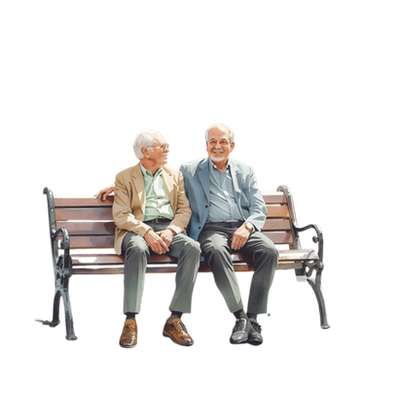
Thank you for sharing your stories and gifts!

