Slide 1
This is intended for communities that are not currently receiving grant funding.
TAKING ACTION AGAINST ELDER ABUSE
Community Response Project- Information Guide for the call for proposals 2024-2025
March 17, 2025, | Joanne Blinco

Slide 2
Who is the AEAAC?
The Alberta Elder Abuse Awareness Council is a group of Albertans dedicated to increasing awareness and supporting a community response to elder abuse.
Representing communities across Alberta- facilitating a collective response to elder abuse
A province-wide network of professionals
Promoting the well-being and security of older adult
Developing resources to address and educate about elder abuse
Supporting communities to respond to elder abuse through awareness and education

Slide 3
PURPOSE
This funding will support case management services provided through Coordinated Community Response (CCR) and increase community capacity to address and prevent elder abuse.
Aims to harness the power of existing or developing CCRs to provide response services through case management to address elder abuse in the communities throughout Alberta.
A key social issue, growing in complexity, is elder abuse. Communities may not have the resources needed to respond and manage these complex cases.

Slide 4
Coordinated community response (CCR)
Coordinated Community Responses (CCRs) are defined as a network of service providers or organizations working together to achieve common goals, in this instance in addressing and preventing elder abuse.
A key component of grant funding is the development of a Coordinated Community Response (CCR), which has already been initiated and is currently in progress within the community.

Slide 5
Funding Call Details
Call for proposals: March 17, 2025
Deadline: All applications and supporting documents must be received by 4:30 p.m. on April 11, 2025.
Sent to elderabusealberta@gmail.com
Funding: Approved applicants may receive funding to a maximum of $50,000 for elder abuse case management services.
A second year will be available.

Slide 6
Funding Call Details
The primary applicant must be a:
  Non-profit group registered under the Society’s Act
  Municipality
  First Nation or Metis Settlement
  Local chapter of a provincial or federal non-profit group
Funding will be provided for new case manager positions
Priority will be given to case manager positions that take a regional approach and/or serve more than one CCR area.
This funding is not intended to replace existing funding for a position already doing this work.

Slide 7
Funding Goals
Improve access to support services for older adults experiencing elder abuse.
Implement a consistent approach to case management practices and elder abuse data collection.
Enhance collaborative relationships by leveraging existing resources to increase community capacity to respond to incidents of elder abuse.
Validate the benefits of case management within a Coordinated Community Responses.
Support grant recipients to develop sustainability plans and identify funding dollars.

Slide 8
Eligible/Ineligible Initiatives
Eligible Initiatives: Positions that provide elder abuse case management services, education, and awareness-raising about the case manager position and elder abuse.
Ineligible Initiatives: Initiatives that work to address frauds and scams, self-neglect, or abuse occurring within a facility that falls under the Protection for Persons in Care Act.

Slide 9
Eligible Costs
Expenses must be directly related to the initiative.
Detailed estimates of all expenditures must be provided in the Budget Template.
Eligible expenses include but are not limited to:
Case manager salary and benefits.
Reasonable travel and subsistence costs directly associated to the provision of case management services (i.e. outreach) or meetings with CCR partners and regional collaborators.
Reasonable costs for the purchase of equipment and supplies that are directly related to and will be used primarily for the initiative.

Slide 10
Eligible Costs Continued
Reasonable expenses related to courses, conferences, or other training opportunities that will enhance the skills or knowledge of the case manager. (Note: there is a maximum spending cap of $200 for this area).
Reasonable expenses for raising awareness or advertising the case manager position and how older adults at risk of abuse can access services and supports in their community. (Note: there is a maximum spending cap of $500 for this area)

Slide 11
Eligible Costs Continued
Reasonable expenses related to courses, conferences, or other training opportunities that will enhance the skills or knowledge of the case manager. (Note: there is a maximum spending cap of $200 for this area).
Reasonable expenses for raising awareness or advertising the case manager position and how older adults at risk of abuse can access services and supports in their community. (Note: there is a maximum spending cap of $500 for this area)

Slide 12

Ineligible Costs
Ineligible expenses include but are not limited to:
Alcohol
Space rental
Monthly parking fees
Expenses incurred prior to application approval
Research
Administration fees
Auditing/bookkeeping and legal fees
Insurance
Development or advertising of general awareness-raising materials

Slide 13
Grant Application
☐ Completed application form
☐ Completed detailed budget template
☐ Two letters of commitment
☐ Current organizational membership list of the CCR group

Slide 14
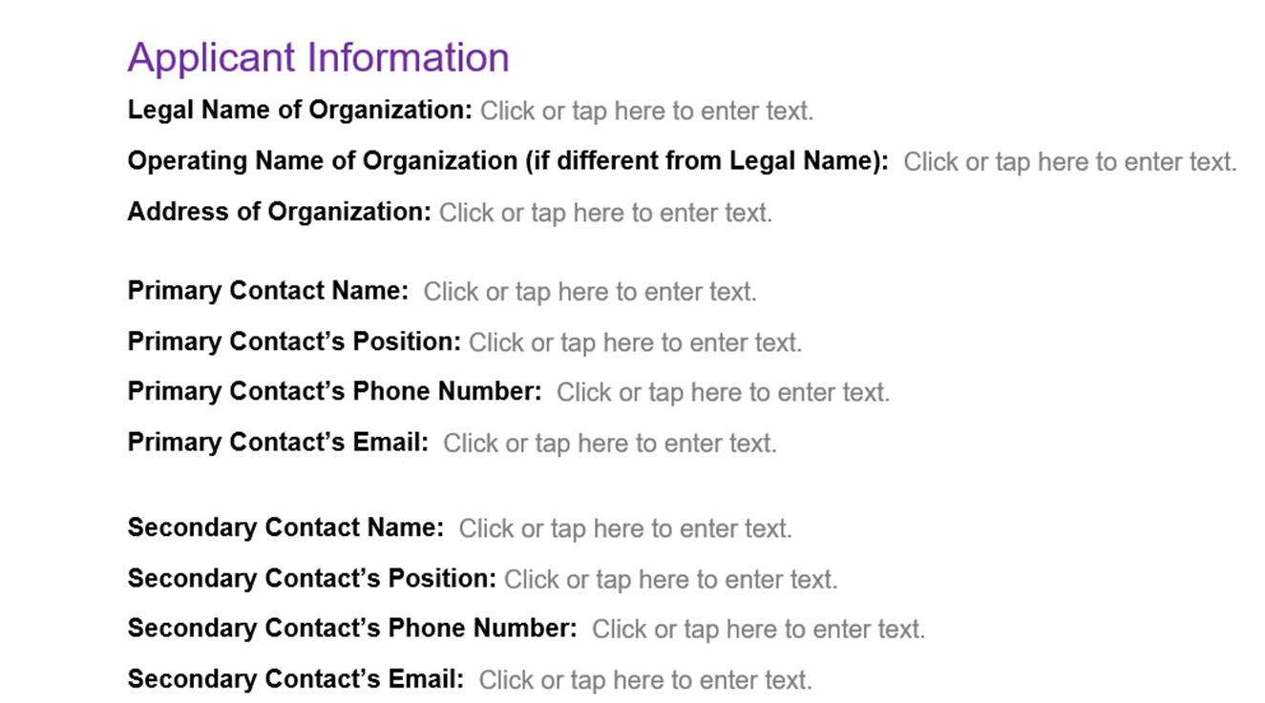
Grant Application Form

Slide 15
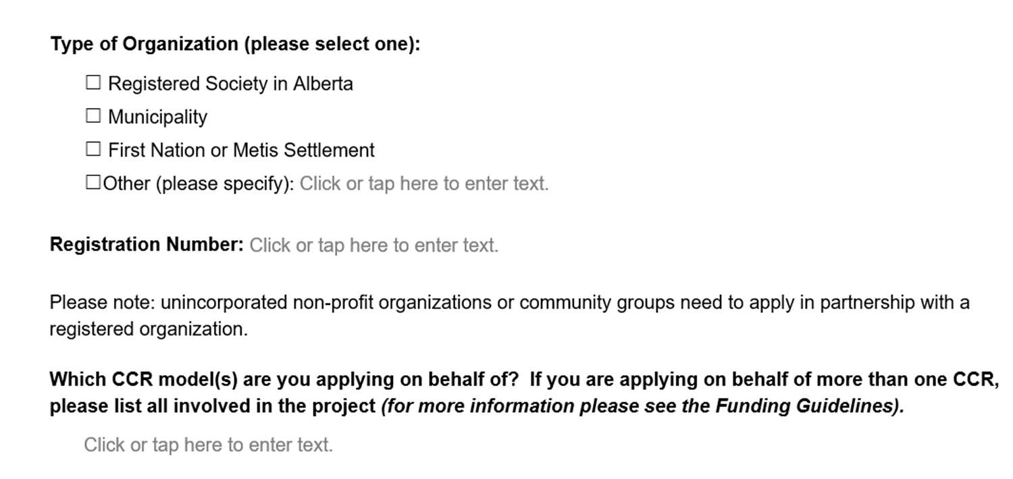
Grant Application Form Continued

Slide 16
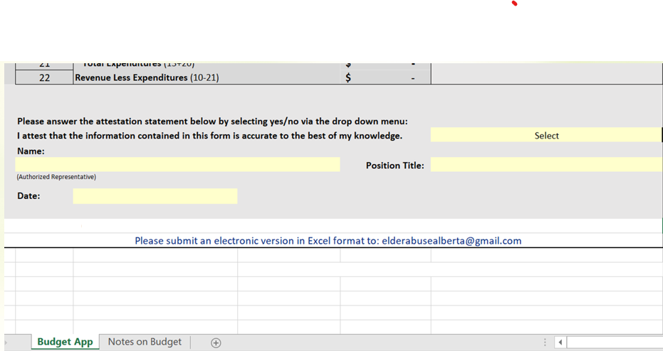
Budget Template Continued

Slide 17
Grant Application Form Continued
Initiative Information
Total amount of funding requested (maximum of 50,000)
What geographic location(s) will be served through this funding?
What is the identified need this initiative will address? Suggestions: please include statistics on the senior’s population in your area, data on any elder abuse cases, themes, or trends from the last year, etc.
How will you address this need?
Seniors are a diverse population with different identities, experiences and needs. How will the initiative account for or consider differences among seniors within the case management approach? This may include thinking about seniors’ varying ages, genders, education levels, languages, cultural ethnicities, abilities, locations (e.g. rural, urban), family status, etc.
Explain how your program will address mental health and addiction for older adults? As well, referrals for family or the person who has caused harm.
Please describe your education and awareness plan for your community (10-15%) (this could include awareness raising about the program and services, about elder abuse, community presentations, World Elder Abuse Awareness Day activities, CCR training, It’s Not Right: Neighbours, Friends and Family, Taking Action Against Elder Abuse, service provider training, etc.) and who would provide them (this could be yourself, other community agencies, volunteers, or contracted trainers).

Slide 18
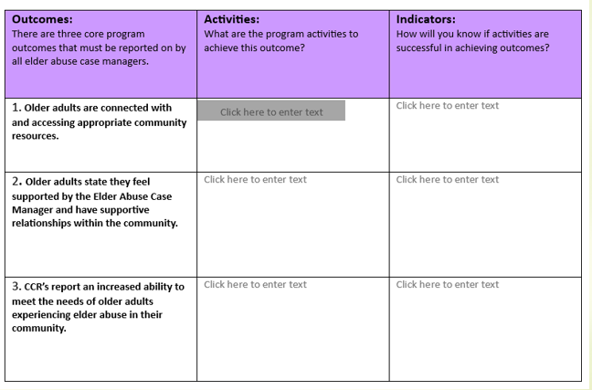
Grant Application Form Continued
Initiative Information Continued
Please describe your coordinated community response (CCR) (10-15%) (this could include how and when you will meet, who is engaged or attending, who will coordinate, what type of work the CCR will do, etc.).
Please describe your case management service provision plan (70-80%) (who will provide them, how many hours per week, where the position(s) will be located, case management model elements, and type of outreach appointments provided – community, in-home, and/or in-office).
10. Please complete the following table to describe how this initiative, if funded, will meet the three set core outcomes as well as any additional outcomes

Slide 19
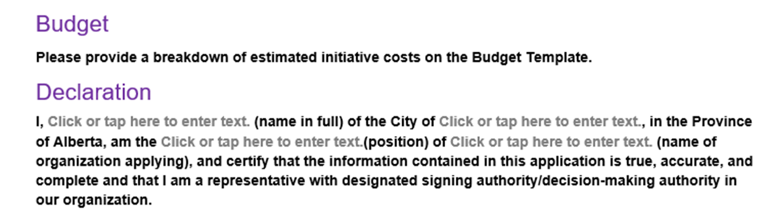
Grant Application Form Continued

Slide 20
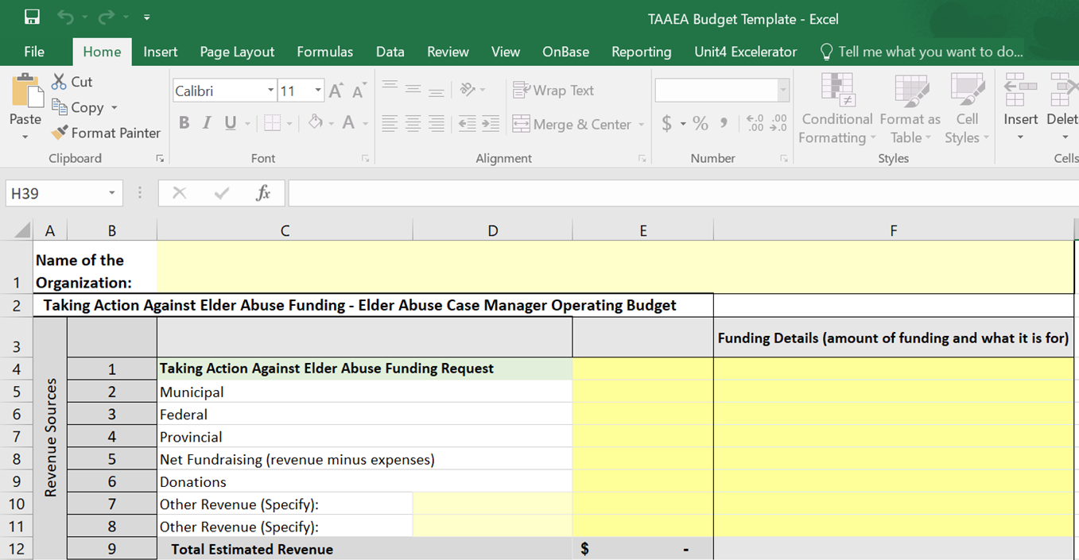
Budget Template
Please include details of all other funding you are receiving, as well as any in-kind contributions.

Slide 21
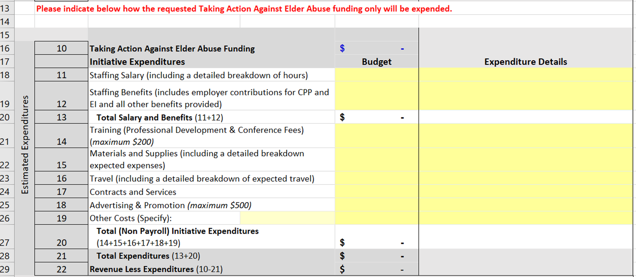
Budget Template Continued

Slide 22

Budget Template Continued

Slide 23
Letters of Commitment
Two Letters of Commitment are required. If this initiative is a regional approach including more than one CCR, a Letter of Commitment from each CCR participating must be included.
Letters of Commitment are different from Letters of Support. Letters of Commitment should indicate the role of the organization within the CCR, their specific contributions to this initiative including in-kind and monetary support, or other investments the organization contributes.

Slide 24
CCR Organizational List
The Organizational List is a listing of all agencies, organizations, service providers who are involved currently with the CCR. There is no need to include names of individuals or their contact information.

Slide 25
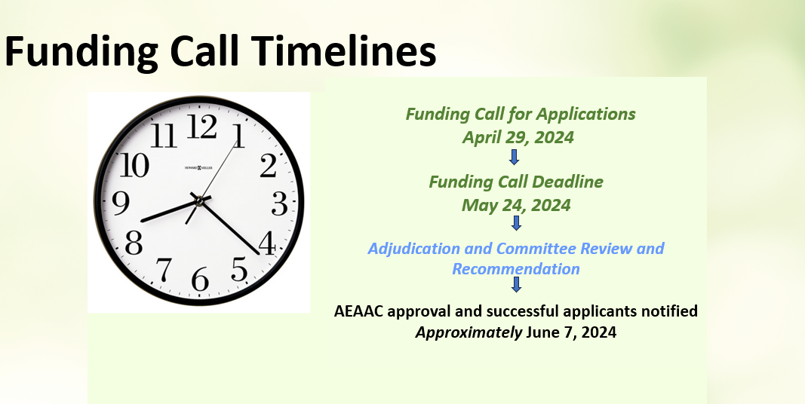
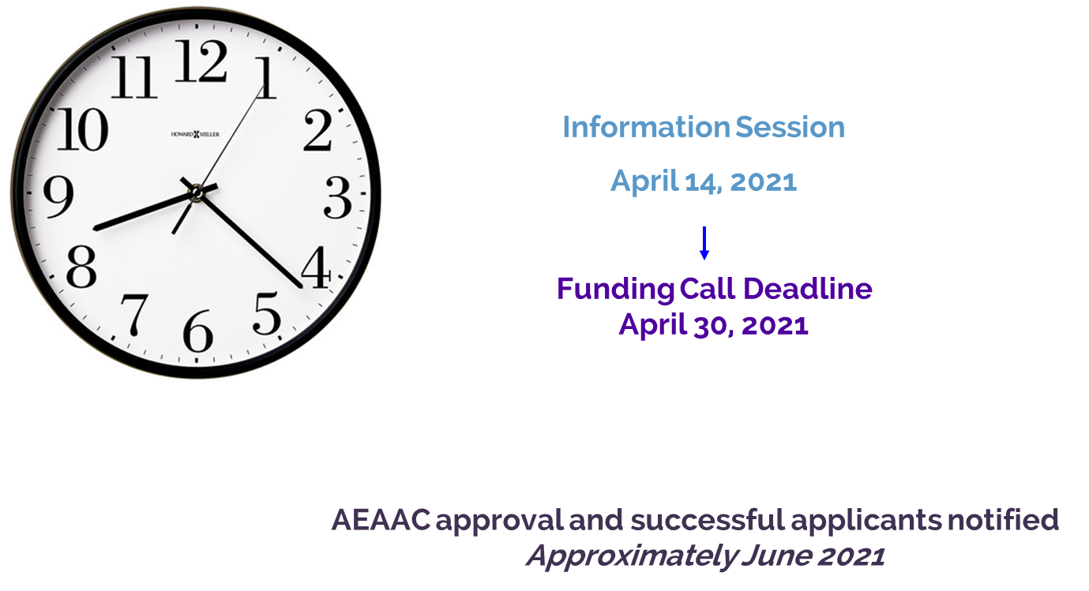
Funding Call Timelines
Funding Call for Applications
April 29, 2024
Funding Call Deadline
May 24, 2024
Adjudication and Committee Review and Recommendation
AEAAC approval and successful applicants notified Approximately June 7, 2024
Funding Call for Applications
April 29, 2024
March 17, 2025
April 11, 2025
May 24, 2024
Adjudication Committee Review and Recommendation
"Applicants will be notified of the results after all grant allocations have been determined."
June 1, 2024

Slide 26
If the Application is Approved
A final Summary Report and a Financial Statement for the initiative will be due at the end of the 6 months and then again at 12 months.
Data requirements will be defined

Slide 27
The AEAAC will:
Host monthly meetings for Case Managers, as well provide additional education supports for them and the CCR’s
Case managers will have a forum for case conferencing
The CCR are asked to have a representative attend a CCR-COP monthly meetings to help build a strong collaborative community response.
Provide training for case mangers to create standardization among service providers across the province.
Provide information on the case work practice model to case workers
Provide a reporting tool for Case Managers to use for evaluation and reporting.
Provide an understanding of safe spaces additional grant funding
To provide to CCR’s other grant funding to assist in creating a sustainability plan and identify potential on-going funds beyond this grant.

Slide 28

Questions
More information can be found at:
www.albertaelderabuse.ca
email Joanne Blinco at elderabusealberta@gmail.com

